Slide 1
Binary-Decimal-Hex Converter
Project by:
Aaron Bading & Douglas Phillips

Slide 2
Project Overview
Converter can take an input in Binary, Decimal or Hexadecimal Format
Outputs value in Binary, Decimal and Hexadecimal Format simultaneously

Slide 3
Input Capture
Input mode is handled with the two left-most binary switches on the DE1-SoC board, SW8 and SW9.
When the switches are set to “00”, the input is captured in binary, using SW0-SW7
When the switches are set to “01”, the input is captured in decimal, using Key0-Key2 to increment the decimal value by 1, 10 or 100, respectively
When the switches are set to “11”, the the input is captured in hexadecimal using Key0 and Key1 to increment the decimal value by 1 or 16, respectively

Slide 4
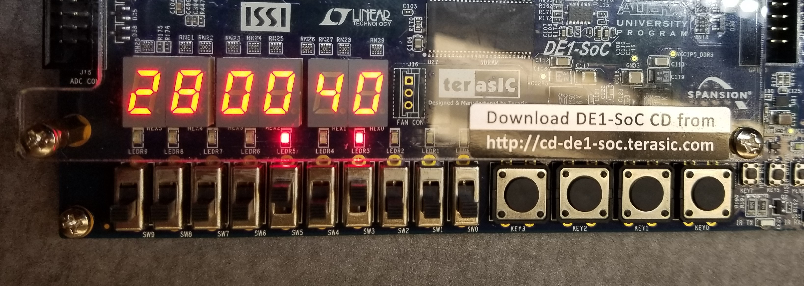
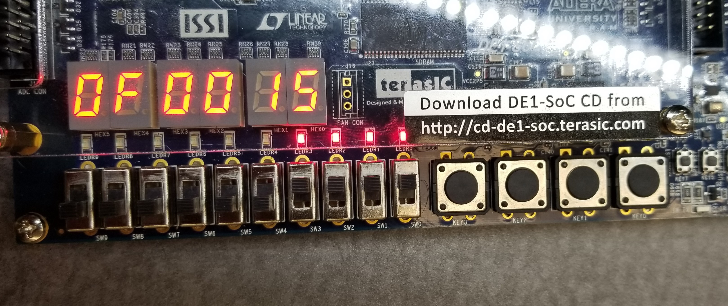
Binary input examples:
Binary input: 00101000
Hex output: 28
Decimal output: 40
Binary input: 00001111
Hex output: 0F
Decimal output: 15

Slide 5
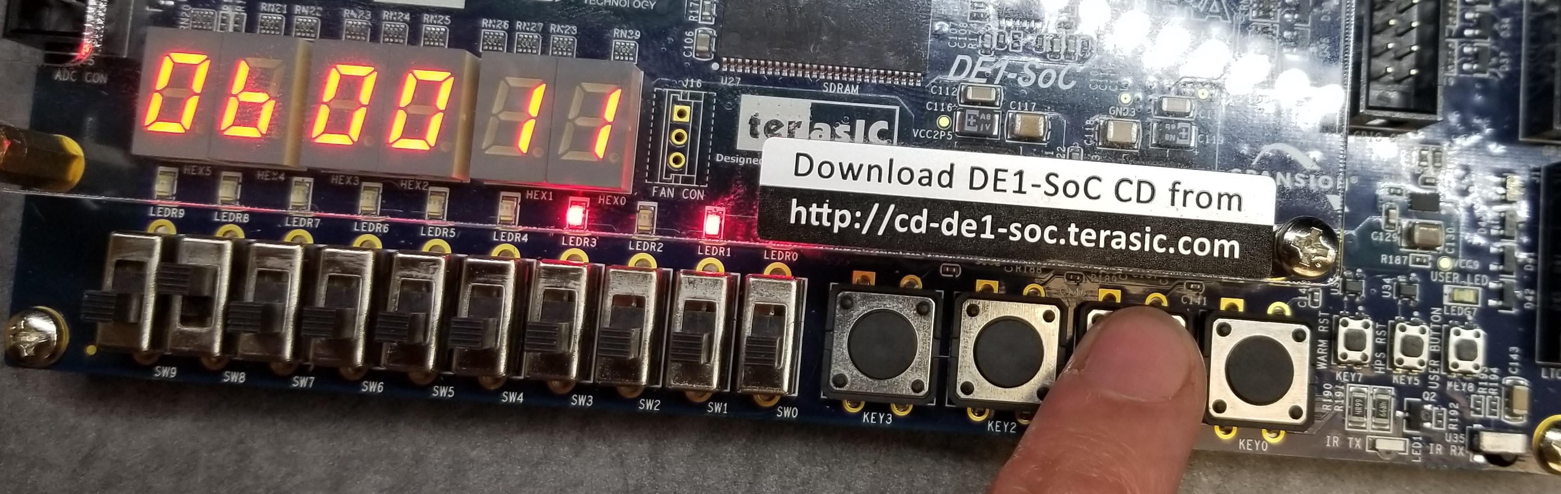
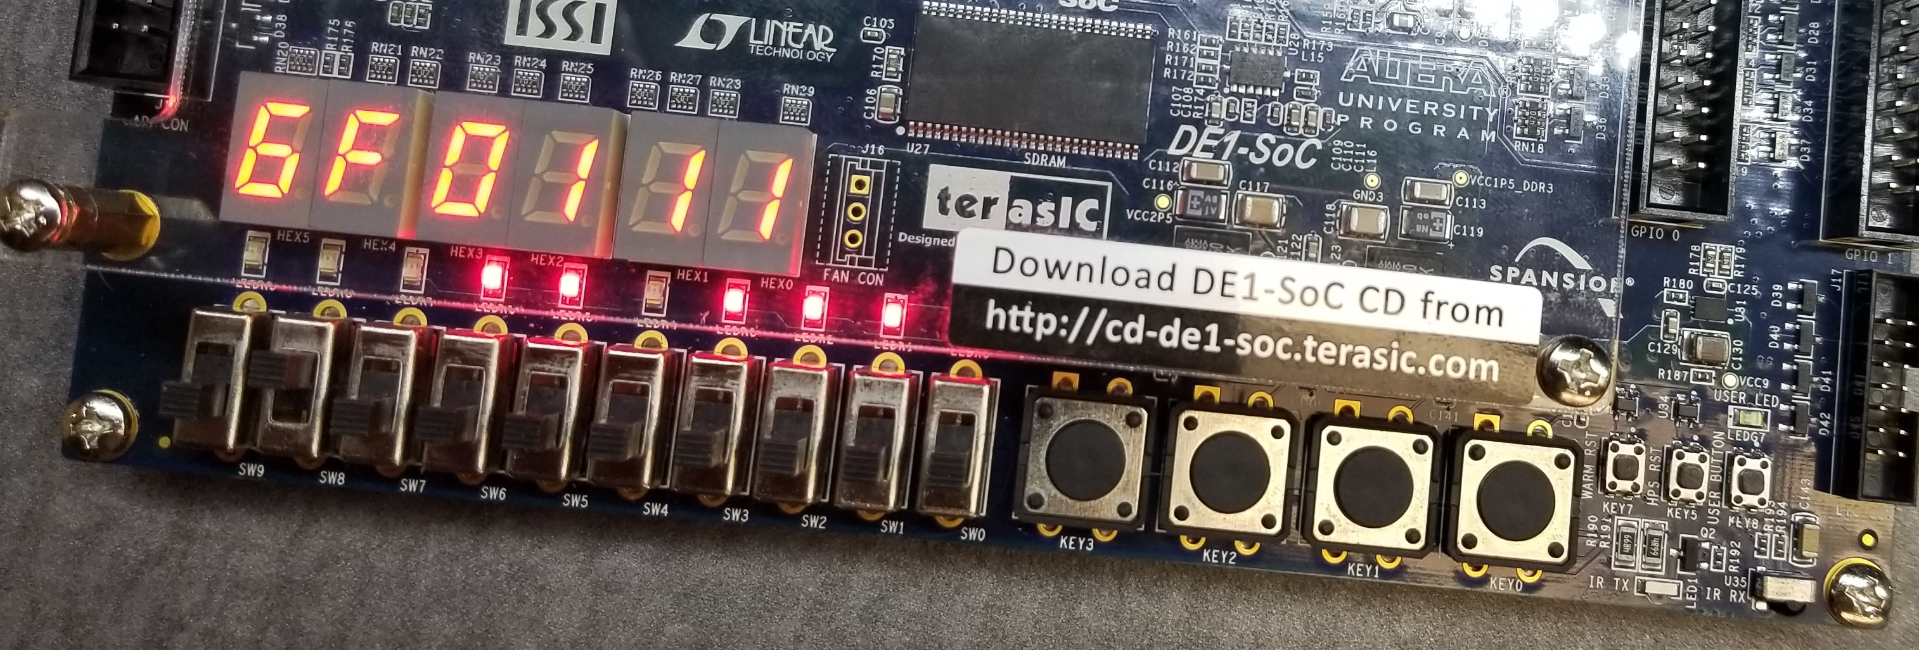
Decimal input examples:
Decimal input: 11
Hex output: 0B
Binary output: 00001011
Decimal input: 111
Hex output: 6F
Binary output: 01101111

Slide 6
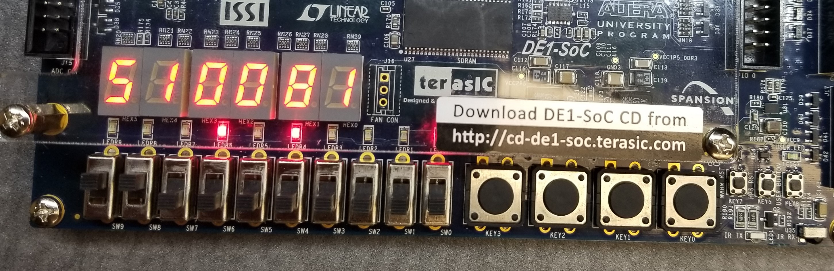
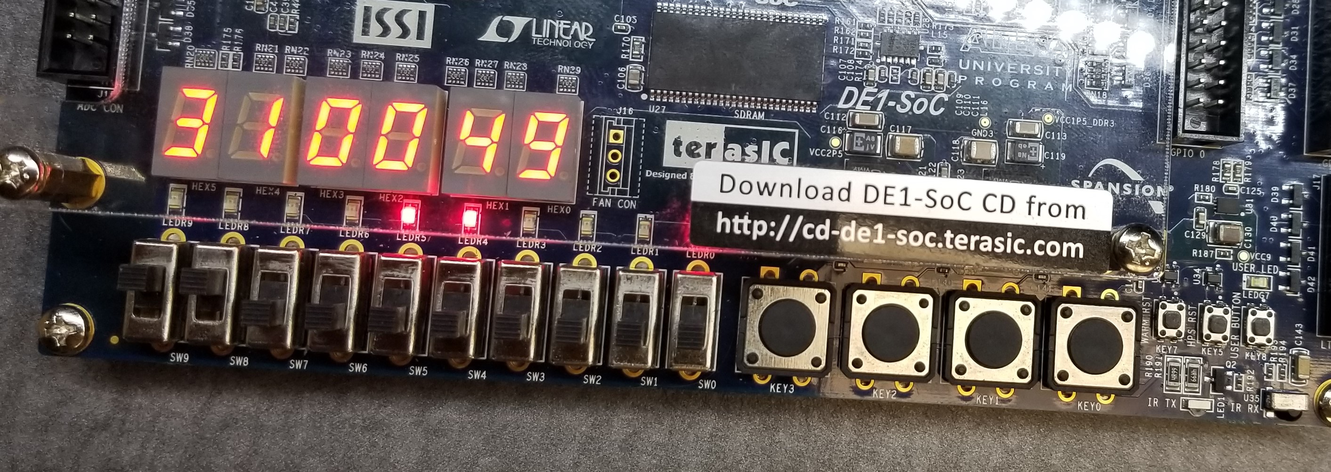
Hexadecimal Input Examples
Hex input: 51
Decimal output: 81
Binary output: 01010001
Hex input: 31
Decimal output: 49
Binary output: 00110001

Slide 7
Code implementation

Slide 8
Input Capture
Projects determines “modebit” value before determining input capture method
If “clear” button is pressed, input it reset to 0

Slide 9
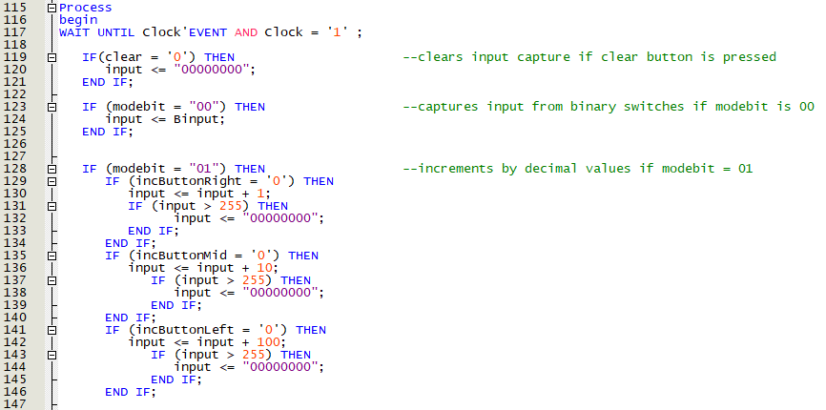
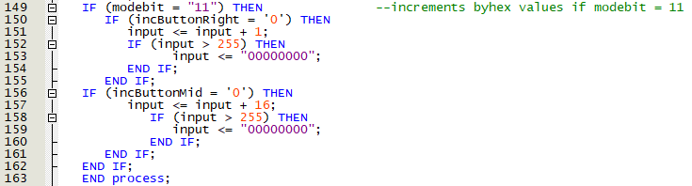
Input capture Code

Slide 10
Output
After input is completed, the input variable value is stored in the “output” variable
The output is mapped to the Binary LEDS, LED0-LED7
It is also mapped to the 7-segment hex display 4 and 5
The output is then mapped to an 8-bit binary to BCD converter, which produces a 12-bit BCD value (for 3 decimal values)
Each group of 4 bits is mapped to the appropriate 7-segment hex display

Slide 11
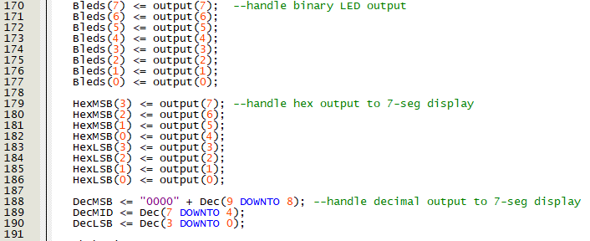
Output Code

Slide 12
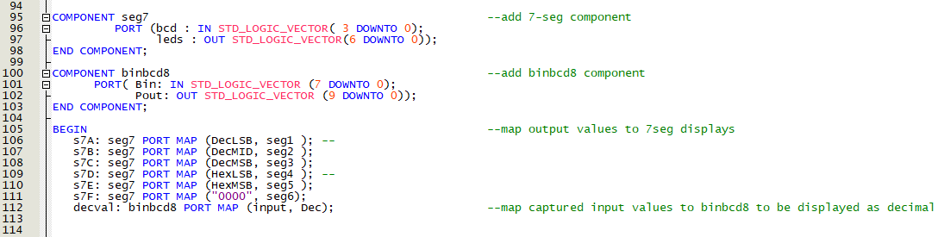
Port mapping
Decimal and Hex bits are mapped to appropriate 7-segment displays
Input is mapped to binary to BCD converter, which returns the 10-bit variable “Dec”

Slide 13
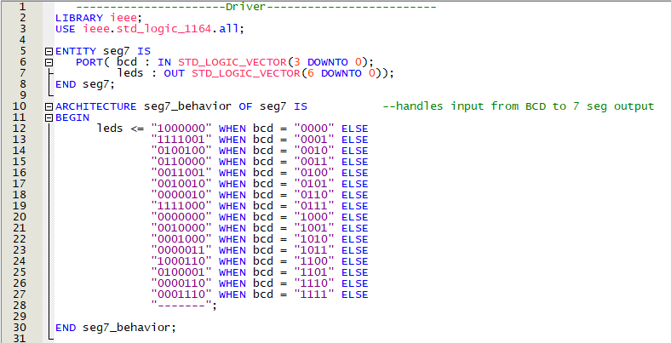
7-Segment Display Driver Code

Slide 14
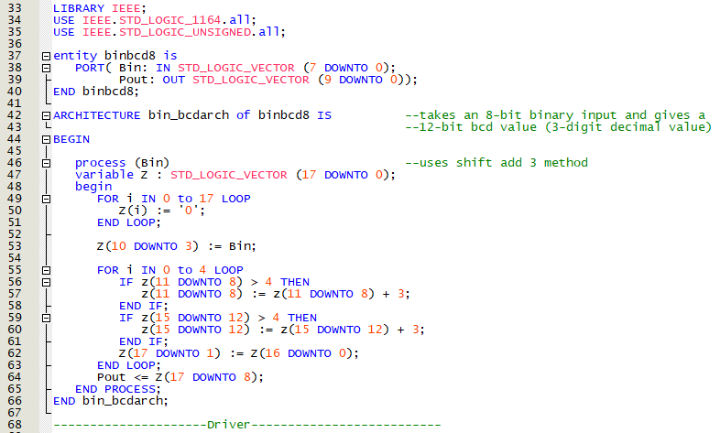
8-Bit Binary to BCD Converter Driver Code
Uses Shift Add 3 method to convert 8-bit binary value to 12-bit BCD value to be displayed as decimal

Slide 15
Complications Encountered
The original implementation for converting from 8-bit binary to decimal did not work at all and resulted from approaching the solution from a C++-type standpoint, using loops and iterations.
Input capture from the push buttons to increment decimal and hex inputs did not work at a fast clock speed due to lack of debouncing on the keys
Solution found was to lower clock speed to 5 Hz, although this was not an ideal solution, time constraints forced it
In the future, it would be beneficial to add debouncing so that the system can work with an appropriately fast clock speed

Slide 16
Conclusion
This project ended up being a difficult solution to implement, due to lack of familiarity with VHDL and nuance with the language necessitating different solutions than other programming languages would allow
All-in-all the project was a very informative process, requiring a lot of trial-and-error and creative solutions.

